Slide 1
BDD
Lesson 02 : Gherkin Language Basics
Notes:
©2016 Capgemini. All rights reserved. The information contained in this document is proprietary and confidential. For Capgemini only.

Slide 2
Lesson Objectives
To understand the following topics:
Introduction to Gherkin Language
Generating Behavior test cases
Running test cases
Creating tags
Categorizing tests based on tags

Slide 3
Introduction to Gherkin Language
Gherkin is a language, that is used to write Features, Background, Scenarios, and Steps.
Gherkin helps us to write concrete requirements.
Gherkin files are plain text Files and have the extension .feature.
Gherkin syntax is simple and readable
Each line that is not blank has to start with a Gherkin keyword, followed by any text you like.
Gherkin is based on TreeTop Grammar which exists in 37+ languages thus you can write your gherkin in 37+ spoken languages.
Notes:
Other Keywords:
Scenario Outline
Examples
""" (Doc Strings)
| (Data Tables)
@ (Tags)
# (Comments)
*

Slide 4
Gherkin Syntax
Gherkin is a line-oriented language like Python and YAML
Each line called step and starts with keyword and end of the line terminates the step.
Tab or space (preferred) are used for indentation.
Comments can be added anywhere but start with a # sign.

Slide 5
Gherkin Keywords
The keywords are −
Feature
Scenario
Given, When, Then, And, But (Steps)
Background
Scenario outline

Slide 6
Example
Feature: Search feature for users This feature is very important because it will allow users to filter products
Scenario: When a user searches, without spelling mistake, for a product name present in inventory. All the products with similar name should be displayed
Given User is on the main page of www.myshopingsite.com When User searches for laptops Then search page should be updated with the lists of laptops

Slide 7
Rules for using Gherkin
Single Gherkin source file should have a description of the single feature.
the source file should have the .feature extension.

Slide 8
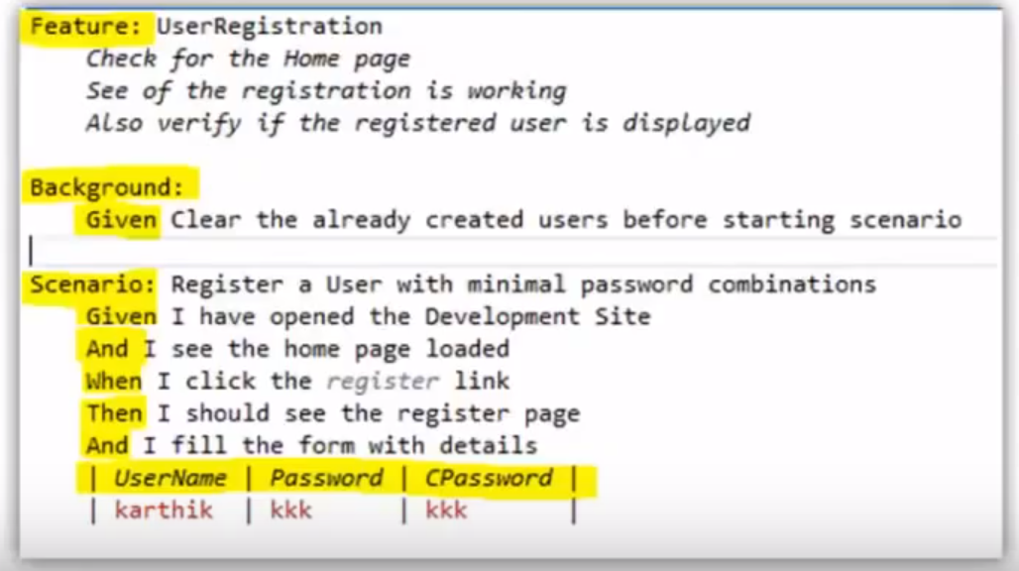
Gherkin Feature file

Slide 9
Feature
Feature acts as a heading for a Scenario
Feature has a list of steps to be performed in particular scenario as a whole
The Feature keyword is used to describe a software feature, and to group the related scenarios.
A Feature has three basic elements
The keyword – Feature.
The name of the feature, provided on the same line as the Feature keyword.
An optional description that can span multiple lines
Feature files are the base files to hold all the scenarios
Notes:
Description in feature holds all the text between the line containing the keyword Feature, and a line that starts with Scenario, Background, or Scenario Outline.
The parser will not interpret any line under feature, since they are just information to the user (Business Analyst, Quality Analyst or Developer)

Slide 10
Background
Backgrounds are used with the scenarios which have common functionalities
They will be executed before every scenario and perform the operation specified
For Example:
In scenarios like checking user settings, profile settings, user information, the common operations are
Launching the application
Login into the application

Slide 11
Feature
Based on the example given anybody can understand the working of the test and what it is intending to do.
It gives an unexpected powerful impact by enabling people to visualize the system even before it has been built.
Any of the business user would read and understand the test and would be able to give the feedback that whether it reflects their understanding of what the system should do, and any other scenario that needs to be considered.

Slide 12
Summary
In this lesson, you have learnt:
Gherkhin Language and its syntax
Creating feature file and generating test cases

Slide 13
Review Question
What will be extension of a feature file?
a. .exe
b. .obj
c. .feature
d. .sfj
Notes:
Q.4.getTitle()
Q.5.True
Q.6. sendKeys()

